Slide 1
30th Anniversary | 2019

Slide 2
Where we were in 1988
No state-wide education
Stepping stone v. career
Some broad authority; some very limited

Slide 3
Where we were in 1988
Limited access to courtrooms – contested hearings in offices
Little staff support or security
Limited or no travel/education budgets
For some, a lack of respect

Slide 4
Where we were in 1988
No robes
No system for connection in place – feeling of isolation for many
No collective voice

Slide 5
1988
The Judicial College reached out to a few referees to discuss education designed by and for referees.
Notes:
Topics
Locations
Identify referees to present
( Needed judge’s permission to present)
Ugly truth:
Referees experts in certain areas

Slide 6
Ohio Association of Court Referees September 23, 1989
Seven Founding members and 38 Charter members funded the start-up expenses and the first meeting in Columbus
67 referees attended the first meeting
Notes:
ask any of the founders or charter members to stand to be recognized
Kate – start up - little bit about the first meeting
Did not recognize the 12th appellate District – quick amendment!
Who fronted the money
buzz in the courts about what we were doing --
Jeff Liston – who became fist president – “ asked “ to meet with Steve Stove Ad Director about what we were doing – then a short meeting with CJ Moyer
OAM to go forward! – not a union – CJ blessing…

Slide 7
Ohio Association of Court Referees September 23, 1989
Bylaws and Board Elections
Few courts paid the association dues
No hospitality suite – all business!
Notes:
ask any of the founders or charter members to stand to be recognized
Kate – start up - little bit about the first meeting
Did not recognize the 12th appellate District – quick amendment!
Who fronted the money
buzz in the courts about what we were doing --
Jeff Liston – who became fist president – “ asked “ to meet with Steve Stove Ad Director about what we were doing – then a short meeting with CJ Moyer
OAM to go forward! – not a union – CJ blessing…

Slide 8
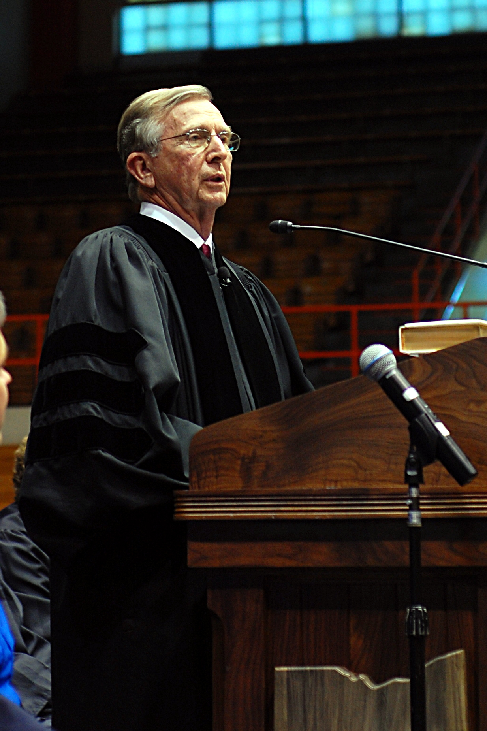
Endorsement of the Association by Chief Justice Thomas J. Moyer
“Your membership, by working together to create the Association, has made this commitment to remain a vital, well-trained, and professional part of the legal system.”
Notes:
Note here that our first brochure came out with this endorsement by the Chief
think we were OACR & M by 1990 – attempt to bring in the statutory magistrates

Slide 9
Birth of the Hospitality Suite | 1990
Notes:
Barb can talk about this time 1989-1995
First HS - in Cincinnati 1990
Added spring conference
District reps held social meeting in their districts – getting to know you!

Slide 10
Let’s change Rule 53
What’s in a name?
Burdensome report writing requirements
Judicial “independent review” of all reports
Notes:
When we got together - this was what we were talking about
Referee – statutory magistrates in mayors courts did Crim R 19 apply to them
What was history with OAR&M?
Report writing:
be the court reporter - necessary facts – COL
as dockets increased – report writing slowed – decision making delayed –
What was the real value –
judges didn’t have to do it!

Slide 11
Let’s change Rule 53
Orders without judicial approval – keep things moving?
Shouldn’t all referees be attorneys?
Make a record of referee proceedings
Notes:
When we got together - this was what we were talking about
Referee – statutory magistrates in mayors courts did Crim R 19 apply to them
What was history with OAR&M?
Report writing:
be the court reporter - necessary facts – COL
as dockets increased – report writing slowed – decision making delayed –
What was the real value –
judges didn’t have to do it!

Slide 12
Strategies for Change (1990 – 1995)
Judicial College – always key to changes
More education available but still separate from judges
OACR&M Conferences - VIP guest lists to raise awareness of the Association
Notes:
Comments – we designed our own – we were pretty good presenters
Judges starting to come to our seminars
Note name change to include statutory magistrates – initial strategy that we dropped later
Mike can speak to some of this.

Slide 13
Strategies for Change
(1990-1995)
1994 – Executive Director hired
Increase membership every year
Invite non-members referees to Association events
Notes:
what other things did we do :
We testified – appeared before judge committees – invited to “explain ourselves”
Private lobbying of judges
WE TRIED TO SELL THE CHANGES TO JUDGES BASED ON LOCAL OPTION ARGUMENT

Slide 14
Strategies for Change
(1990-1995)
1993 - Mike Bernstein, Judicial College board seat
1993- Barb Norton, Rules Advisory Committee seat
1994- DR judges invited referees to join new DR Judges Association
Notes:
what other things did we do :
We testified – appeared before judge committees – invited to “explain ourselves”
Private lobbying of judges
WE TRIED TO SELL THE CHANGES TO JUDGES BASED ON LOCAL OPTION ARGUMENT

Slide 15
Strategies for Change
(1990-1995)
Encourage “spirited” discussions at Association and Judicial College gatherings
Notes:
what other things did we do :
We testified – appeared before judge committees – invited to “explain ourselves”
Private lobbying of judges
WE TRIED TO SELL THE CHANGES TO JUDGES BASED ON LOCAL OPTION ARGUMENT

Slide 16
The Power of the Hospitality Suite
Notes:
Barb can talk about this time 1989-1995
First HS - in Cincinnati 1990
Added spring conference
District reps held social meeting in their districts – getting to know you!

Slide 17
1995 Rule Amendments
Title changed to Magistrate for almost all referees
Dramatically changed report writing requirement – short form decision

Slide 18
1995 Rule Amendments
Contempt powers
Proceeding to be recorded
Notes:
Talk about Miele v. Ribovich 2000 that held that the S Ct said what it meant and meant what it said about the short form decision. - ( absent local direction to do otherwise, ok to do short form decision ( eviction case)

Slide 19
1995 Rule Amendments
New Standard of Judicial Review
Expanded areas for magistrate orders

Slide 20
1995 Rule Amendments
Authority to hear jury trials specifically stated
New magistrates must be attorneys
Notes:
All the hard work paid off! No obj- adopted unless apparent error / no ind review unless objection
expanded subject matter of orders that remain effective until stay granted - had been very specific in prior rules
Jury trials – could we or couldn’t we?
Juvenile magistrates did not need to be attorneys
Confirmed that proceeding before magistrate same as if by judge.

Slide 21
2000 - Amendments to Crim.R.19
Not limited to arraignment/preliminary matters
Guilty and no contest in misdemeanor cases
Contested non-jury cases with consent if jail possible penalty
Notes:
despite discussion about special constitutional and procedural issues, Crim. R. was successfully redesigned to track Rules 53 and Rules 40.
Lot of resistance from municipal judges – really careful lobbying
Once again – LOCAL OPTION CARRIED THE DAY!

Slide 22
2000 - Amendments to Crim.R.19
Recommend sentences
Issue TPOs
Expanded areas for pretrial orders

Slide 23
2006 – Rule Amendments
Major reorganization of all magistrate rules
Easier to follow the steps for magistrate, judges, and litigants
Authority to issue civil TPO (judge’s signature required)
Notes:
many magistrates were in the position to explain to judges what they had to do.
(KG – over 31 years – worked for 64 judges – needed to explain to judges what they were supposed to do. - many magistrates were in that position to make sure their judges followed the right procedures
Failure to enter judgment – consistent problem and subject of a lot of appellate decisions.

Slide 24
2006 – Rule Amendments
Removed restrictive “pretrial orders” and expanded authority to any order necessary to regulate the proceeding
FOF and COL directed to magistrate, not judge
Notes:
many magistrates were in the position to explain to judges what they had to do.
(KG – over 31 years – worked for 64 judges)
Waiver rule - even if something is not labeled FOF or COL – if you fail to object – waived.

Slide 25
2006 – Rule Amendments
Waiver rule clarified again
Minimum standard of review - not any error of law but error of law evident on its face
Judge must enter judgment.
Notes:
emphasize on this slide –
for a long time – single largest assignment of error was a judge’s failure to enter judgment - judges would adopt but not enter judgment.

Slide 26
2008– Sup. R. 19
First experience requirement for magistrates
Practice of law at least 4 years and in good standing (later incorporated in other magistrate rules)
Notes:
many magistrates were in the position to explain to judges what they had to do.
(KG – over 31 years – worked for 64 judges)
Waiver rule - even if something is not labeled FOF or COL – if you fail to object – waived.

Slide 27
2012 – Civ. Rule 65.1
New: procedures unique to protection orders
Broadened the authority of magistrates to conduct protection order proceedings in all courts.
Magistrate denial or granting of an ex parte protection order without judicial approval not subject to Civ.R. 53
Notes:
Have Mark H discuss this

Slide 28
2018 – Sup. R. 19
Adm Judge required to report appointment and termination of a magistrate to Supreme Court
Magistrate oath of office required and must be filed in Clerk’s office
Notes:
oath not to be filed in personnel file
other recommendations that came out of that subcommittee

Slide 29
Magistrates added to Judicial Conference committees
Magistrates added to Supreme Court task forces and commissions
Mark Huberman – Chair of Commission on Rules of Practice and Procedure

Slide 30
OAM issues comments on proposed changes to Court Rules
Mentoring program
Required CLE hours to match those of judges

Slide 31
Close relationship with the Judicial College
More magistrate courses
New Magistrate Orientation mandatory
Judicial College publishes OAM newsletters
Notes:
Mark can talk about the status of the association today

Slide 32
Our Biggest Achievements
Professionalism
Collegiality
Membership
Networking
Professional and Personal Friendships
Notes:
Membership numbers’’ can we compare 1989 to now?
Kate - comment
Networking – example - recent “scandal” in foreclosure cases in Franklin Cty Franklin Cty magistrate alerted to scam thru CLE at OAM conference . Newspaper reported that!

